Slide 1


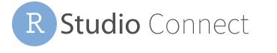
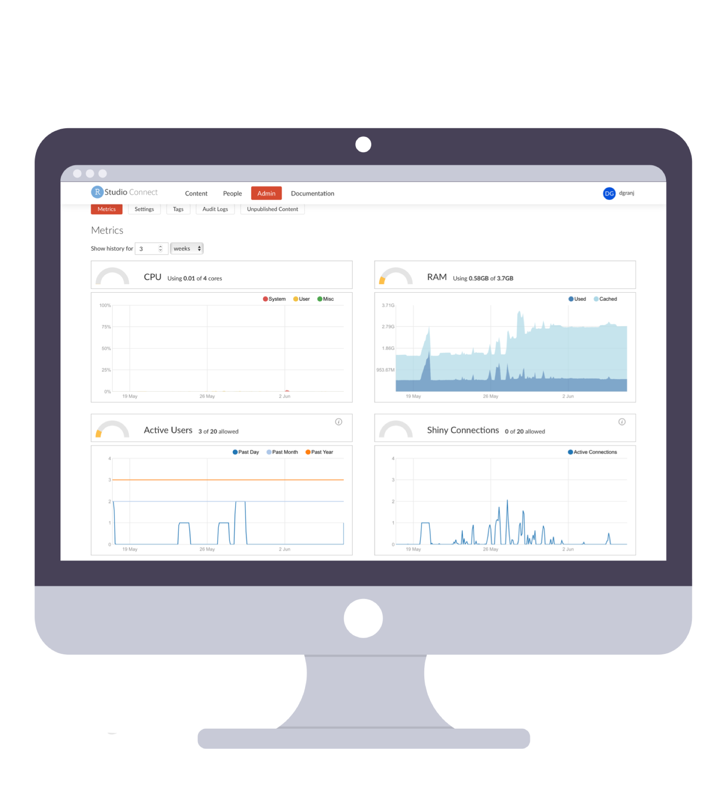


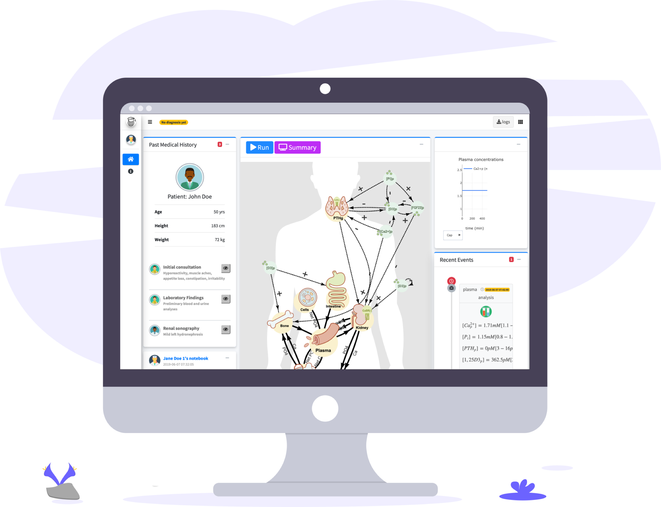




Shiny Powered Virtual Patients
David Granjon, Olivier Bonny, François Verrey, Vartan Kurtcuoglu and Diane de Zélicourt

